Slide 1

PERFECT COMPETITION
CHAPTER – 8

Slide 2

Market structure
Market structure refers to the way that various industries are classified and differentiated in accordance with their degree and nature of competition for products and services. It consists of four types: perfect competition, oligopolistic markets, monopolistic markets, and monopolistic competition

Slide 3
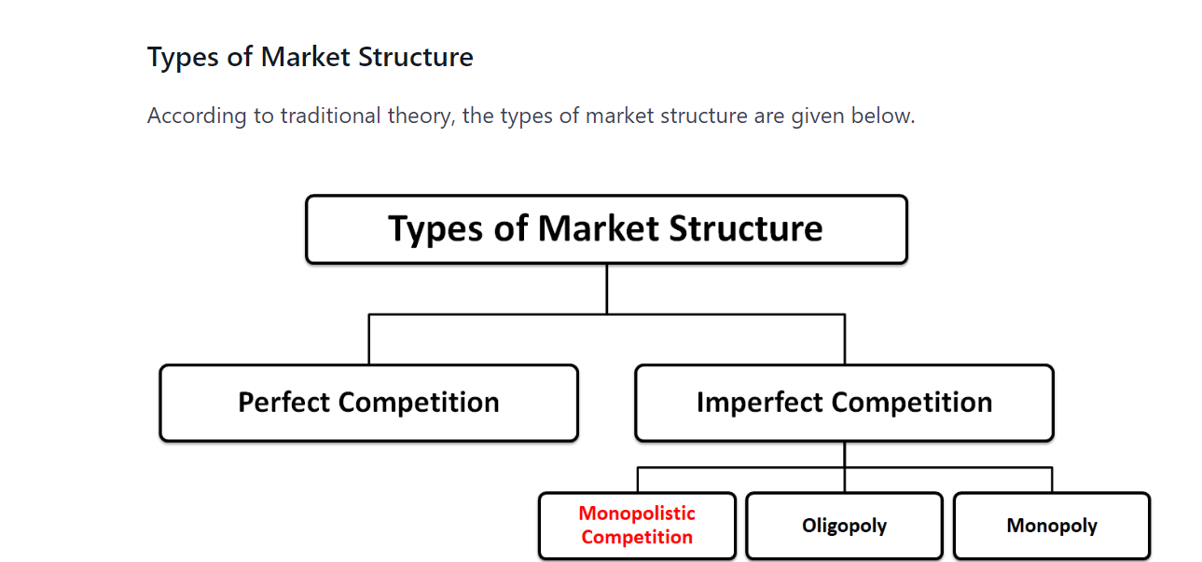
Types of Market Structure

Slide 4
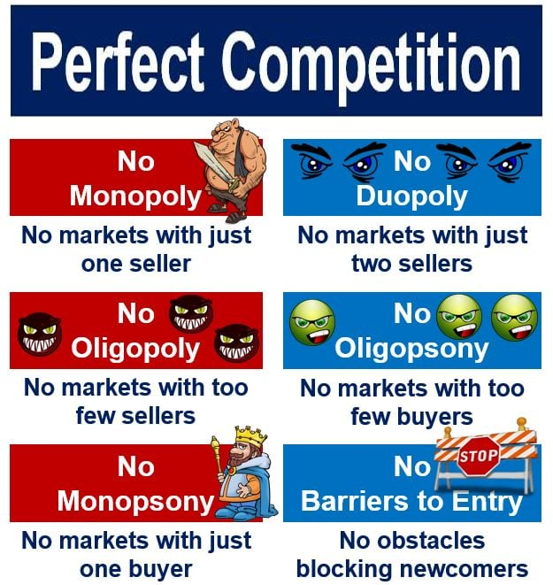
PERFECT COMPETITION

Slide 5
MONOPOLY

Slide 6
IMPERFECT COMPETITION

Slide 7
OLIGOPOLISTIC MARKET

Slide 8
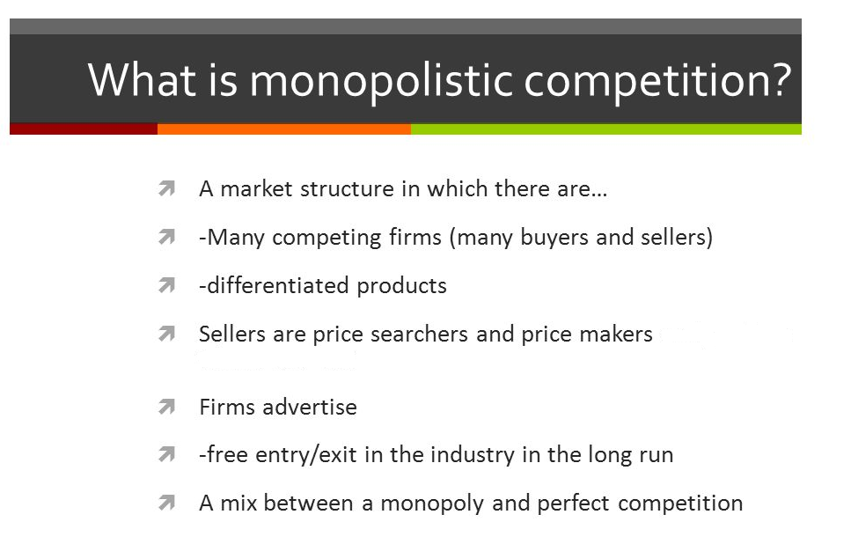
MONOPOLISTIC COMPETITION

Slide 9
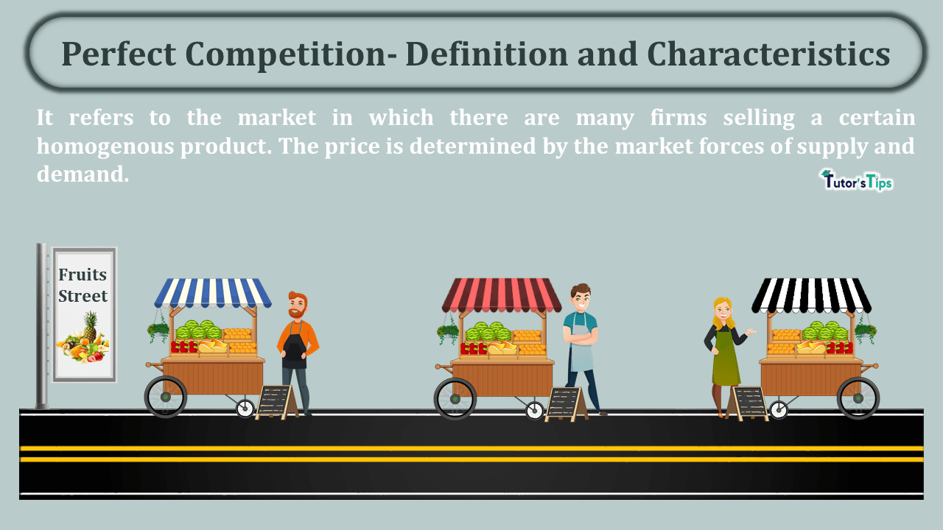
PERFECTLY COMPETITIVE MARKETS

Slide 10
Assumptions of Perfectly Competitive Markets

Slide 11
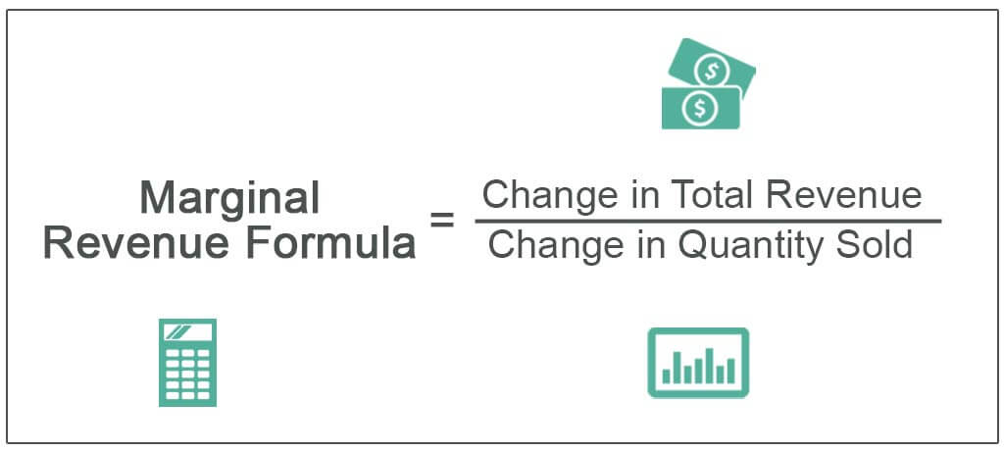
AVERAGE AND MARGINAL REVENUE

Slide 12
SHORT-RUN EQUILIBRIUM UNDER PERFECT COMPETITION

Slide 13
LONG-RUN EQUILIBRIUM UNDER PERFECT COMPETITION

Slide 14
ALLOCATIVE EFFICIENCY
Allocative efficiency is a state of the economy in which production is aligned with consumer preferences; in particular, every good or service is produced up to the point where the last unit provides a marginal benefit to consumers equal to the marginal cost of producing.

Slide 15
CONCLUSION
In conclusion, the concept of market structure is central to both economics and marketing.

